Slide 1
Noise Filtering
Summary & Manual

Slide 2
SUMMARY
Goal: observe target folder and remove noise image (if it comes)
Sub-goal: to save normal images as many as possible
First step before passing the image to M/N classifier

Slide 3
File Watcher (watchdog)
To observe activities happened in <target_path>.
on_create: when file or folder is created.
on_delete: when file or folder is deleted.
Speed: 5-8 images per sec depending on MODE

Slide 4
Noise Filtering
Three functions to check whether an input image is noise
Deep learning model
Blur Detection
Ratio Removal

Slide 5
(1) Deep Learning Model: resnet50_299.pkl
Pre-trained Resnet50
Input image size: 299
Trained with
#normal: 7,108
#noise: 7,380
Accuracy: 0.9887
Confusion Matrix:
 | Normal | Noise
Normal | 957 | 6
Noise | 16 | 985

Slide 6
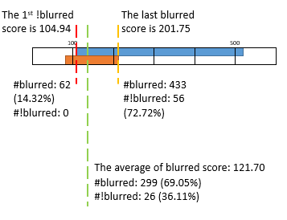
(2) Blur Detection
Our model cannot fully detect blurred images.
Computer Vision: variation of the Laplacian (edge detection)
Threshold: 121.70*
*might be changed

Slide 7
(3) Ratio Removal
To remove the less cell image before passing it through binary classifier (M/N)

Slide 8
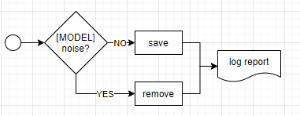
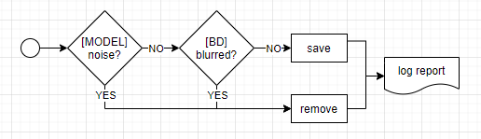
COMBINATIONS
1: Model Only
2: Model + Blur Detection

Slide 9
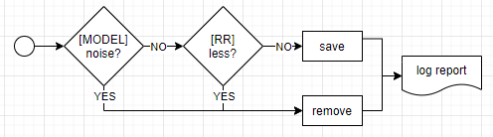
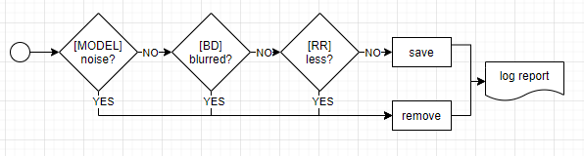
COMBINATIONS (2)
3: Model + Ratio Removal
4: Model + Blur Detection + Ratio Removal

Slide 10
MANUAL
File location (server): Desktop\FileWatcher_test\210309_NoiseFiltering

Slide 11
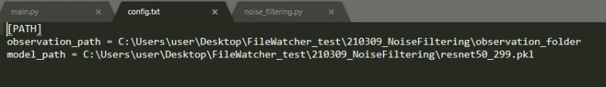
Configuration File
“config.txt”
Observation path: path to watch/observe
Model path: path to model

Slide 12
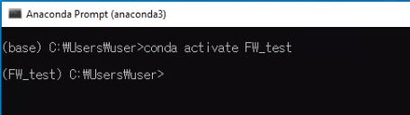
Test Environment
Anaconda environment: “FW_test”
Command to activate environment (anaconda prompt)
conda activate <env>

Slide 13

Run the test file
Test file: main.py
Command
python <file_path> <MODE*>
*MODE = 1 (default), 2, 3, 4
MODE | Description
1 | Model Only (default)
2 | Model + Blur Detection
3 | Model + Ratio Removal
4 | Model + Blur Detection + Ratio Removal

Slide 14
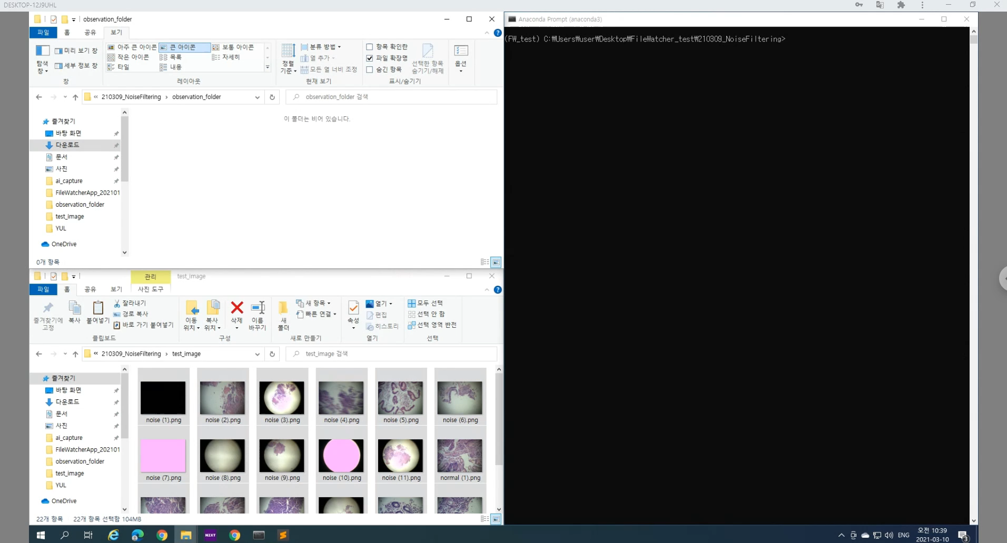
Run the test file – Demo

Slide 15
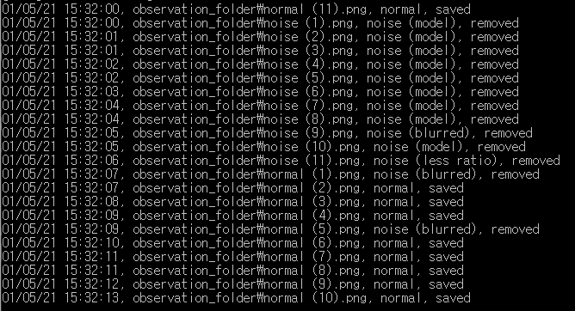
Run the test file – Result (LOG)
LOG format: date time, file path, result, status
Date: DD/MM/YY
Time: HH:MM:SS
Result: normal/noise*
Status: saved/removed
*If an image is detected as “noise”, the result will show which step (model, blur detection, ratio removal) determine it as a noise image.

Slide 16
Run the test file – Other validations
New folder is created.
Non-image file is found.
“Ctrl+c” to exit the watcher

Slide 17
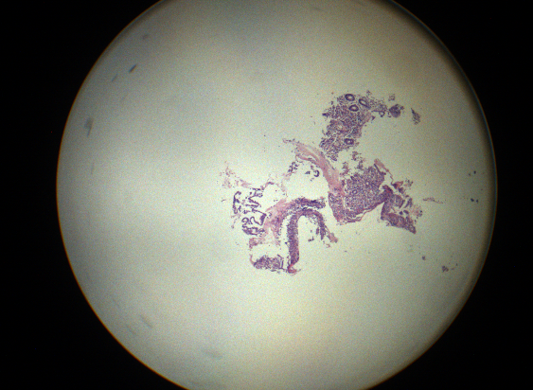
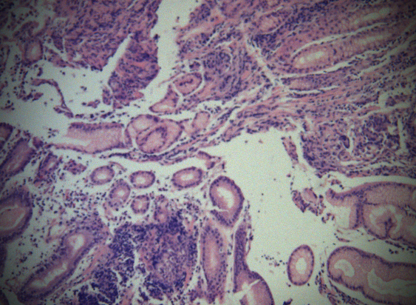
Pilot Result
Data: test_image folder (11 normal images, 11 noisy images)
MODE (COMBINATION) | # normal remained | # noise remained
1: Model Only (default) | 10 | 0
2: Model + Blur Detection | 9 | 0
3: Model + Ratio Removal | 10 | 0
4: Model + Blur Detection + Ratio Removal | 9 | 0
Normal(5).png was misclassified by every MODEs.
Normal(1).png was misclassified by MODE#2 and #4.

